Slide 1

Bus Reservation System
Reserve ur ride.com
Group 5 Team:
Nishi Jain
Anurag Singh
Mithilesh Joshi
Sanjana Minocha
Rasee Ranjan
Charu Yadav
Chaitanya Joshi
Ateev Agarwal

Slide 2
Introduction
Bus Reservation System helps you find bus routes and tours with ease.
The system allows you to plan, schedule and manage unlimited routes with start and end destinations, show bus schedules with the departure times of all buses of a specific route, seat details.
Add various bus types, show seats number and a seat map.
Add multiple bus routes with boarding and arrival points.
View seats details with passenger details.

Slide 3
Problem Statement
Existing system is totally on book and thus a great amount of manual work has to be done. The amount of manual work increases exponentially with increase in services.
In existing system, there are various problems like keeping records of items, seats available, prices of per/seat and fixing bill generation on each bill.
Finding out details regarding any information is very difficult, as the user has to go through all the books manually.
Major problem was lack of security.
The proposed system is very simple in design and to implement. It has got following features:
Records are efficiently maintained by DBMS which provides security for the information.
Availability of seats can be enquired very easily.
Passengers can also cancel their tickets easily.

Slide 4
Features
Oracle Database
Hibernate
Spring IOC
Spring MVC
JavaScript
Angular JS

Slide 5
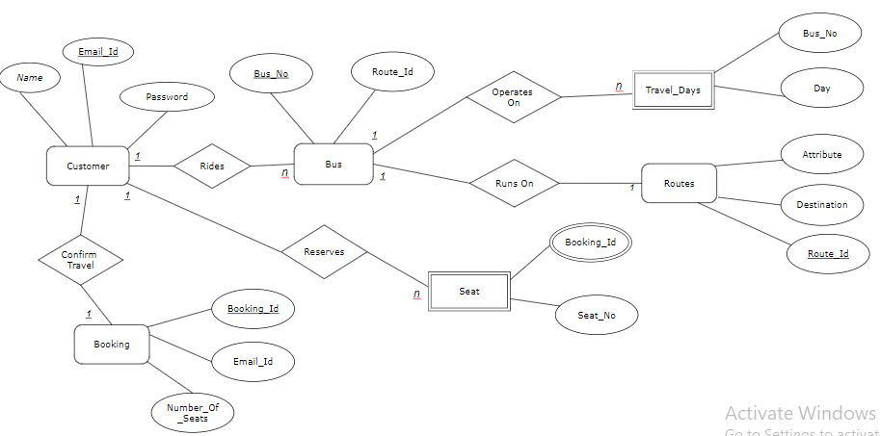
ER Diagram
Travel Days

Slide 6
Scope

Slide 7
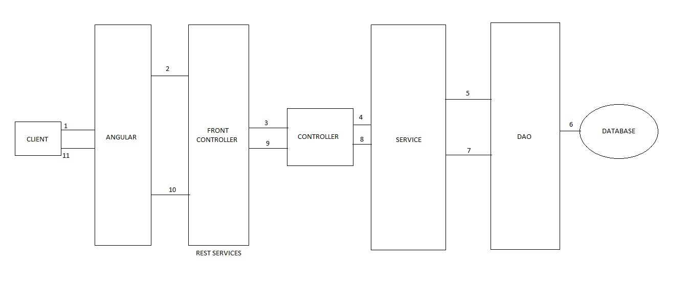
Web Architecture

Slide 8
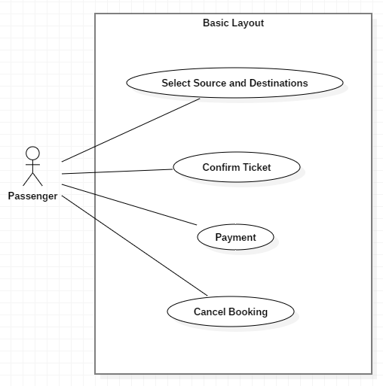
UML Diagrams
Use Case:

Slide 9
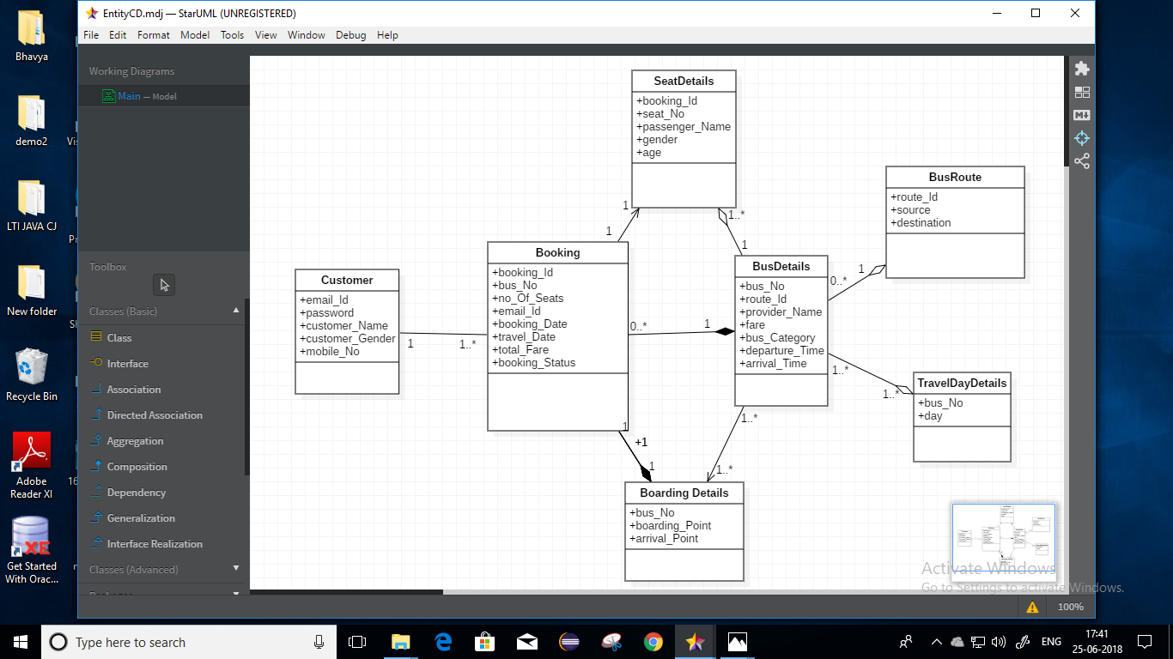
Continue…
Class Diagram(Entity):

Slide 10
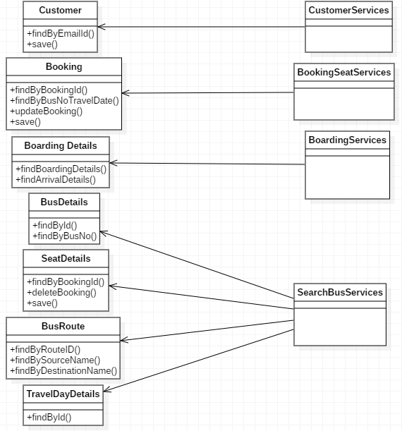
Continue…
Class Diagram(DAO):

Slide 11
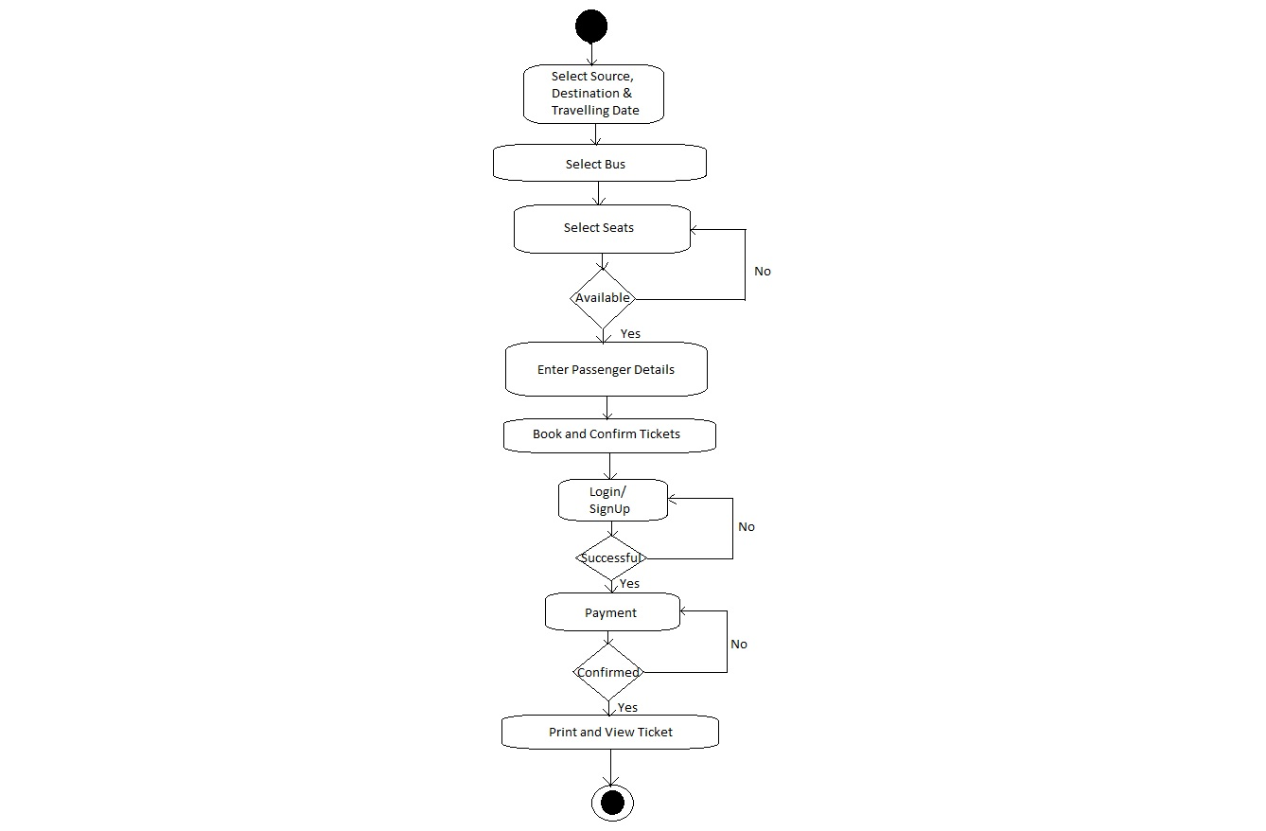
Continue…
Activity Diagram:

Slide 12
Conclusion
Select source, destination and traveling date
Select Bus
LogIn/Sign up
Successful
No
Yes
Select seat
No
Successful
Yes

Slide 13
Thank You

